Slide 1











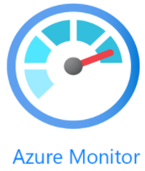



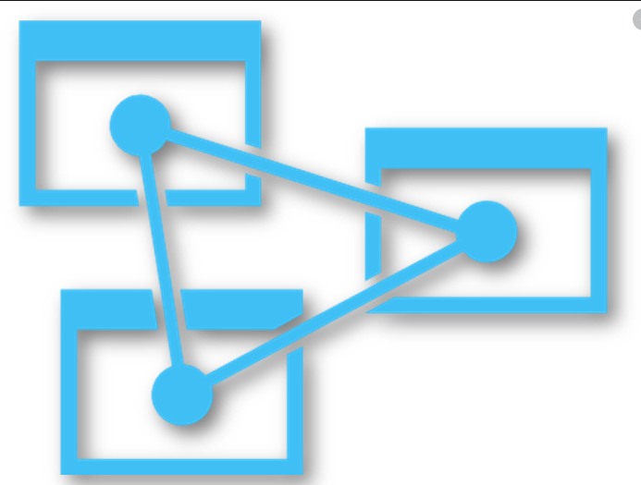






외부 사용자
Azure cloud
Web Server
10.0.0.0/24
B2S
B2S
B2S
B2S
B2S
Internet
Firewall
WAF
NAT gateway
Was Server
10.1.0.0/24
10.4.0.0/24
Functions
10.5.0.0/24
B4MS
B4MS
B4MS
활동로그
Azure 리포트
DB Server
Availability Zone 1
Availability Zone 2
Azure Analysis Service
WEB
Container
WAS
Container
DB for MySQL DB
10.3.0.2/24
DB for MySQL DB
DB for MySQL DB
Logic apps
Company
VPN
내부 사용자

